Slide 1
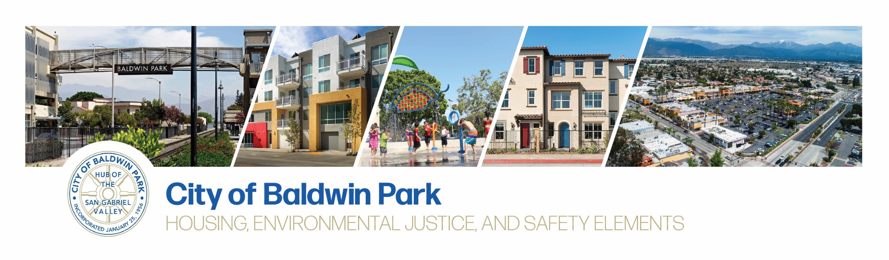
Community Workshop October 28, 2020
Housing Element

Slide 2
Agenda
Introductions
General Plan
Housing Element Overview
Environmental Justice Overview
Process Overview and Public Engagement
Share your thoughts:
What are the key housing issues in Baldwin Park?
How can City policies best address local housing needs?
Notes:
Slide 2:
Hello! We’d like to start today with introductions and then we will provide an overview the City’s General Plan – specifically the Housing Element, as well as review how folks can get involved in the process and next steps. We will then discuss your thoughts on local housing issues and opportunities to address those issues.

Slide 3
General Plan Overview

Slide 4
A General Plan…
Belongs to the community and reflects local vision and values
Long-term plan for maintenance and change
A “living” document that can be adjusted over time
Comprehensive
Required elements
Defined planning area and/or subareas
Planning horizon of 15 to 25 years
Notes:
Slide 4.
A general plan is the guiding document for a community, developed to reflect the local vision for the community today and moving forward. Through amendments, it can be adjusted over time to respond to change. It is a comprehensive document, with 8 required elements or chapters, ranging from transportation to noise to open space. General Plans generally look out toward the next 15 to 25 years – however Housing Elements look at the next 8 years.

Slide 5
Housing element
Notes:
Slide 5
The Housing Element is one of the state-required general plan elements.

Slide 6
Housing Element Basics
A state-required element of the General Plan
Only General Plan element that requires review and “certification” by a State agency, the Department of Housing & Community Development (HCD)
2021-2029 update due October 15, 2021
Notes:
Slide 6
It is the only element that goes through an extensive review and certification process by a State agency, the Department of Housing and Community Development (or HCD). The Housing Element must be updated on a state-determined eight-year cycle. If adopted on time and in compliance with all state laws, the Housing Element is valid for eight years. If not adopted on time, the Housing Element is valid for only four years before an other update is required. This update is due October 15, 2021.
Without a state-certified Housing Element, cities face:
Potential litigation
Ineligibility for funding/grants
Penalty in subsequent Housing Element updates

Slide 7
Housing Element Legislative Intent
“The availability of housing is of vital statewide importance…[and] local and state governments have a responsibility to use the powers vested in them to facilitate the improvement and development of housing to make adequate provision for the housing needs of all economic segments of the community.”
Notes:
Slide 7.
The housing element is a unique element of the general plan because much of the housing element is driven by state-wide legislative intent, rather than local preference. The legislature has declared that the availability of housing is of vital statewide importance. Local and state governments have a responsibility to facilitate the improvement and development of housing to address housing needs for all economic segments of the community.

Slide 8
Housing Element Content
Constraints to Housing Development
Governmental
Nongovernmental
Market
Environmental
Infrastructure
Resources and Sites Inventory
Housing Sites for all Income Levels
Administrative Resources
Financial Resources
Housing Plan
2021-2029
Progress
How City measures up in implementing previous Housing Element
Needs Assessment
Demographic Trends
Housing Market Trends
Special Needs Groups
Notes:
Slide 8.
The Housing Element has 5 main components. The first is a Needs Assessment, which looks at local population characteristics, the housing needs of special needs groups, and the local housing market to establish the baseline for the document. The constraints section reviews the City’s policies and procedures to identify any ways the city is constraining housing development, through zoning, processes, and procedures. It also looks at nongovernmental constraints, like the market.
The Resources and sites inventory chapter looks at the Regional Housing Needs Allocation (RHNA) – which we will discuss more in a few slides – and available sites in town that are vacant or underutilized where new housing could be built. It also identifies grants and public agencies that can support more affordable housing.
The Housing Element also looks at the previous housing element and the accomplishments towards meeting the goals identified in that housing element.
All of these components build toward the Housing Plan, which includes the City’s housing goals, policies, and implementing programs.

Slide 9
What is Affordable Housing?
Affordable housing: a household paying no more than 30% of its annual income on housing
Cost burden: When monthly housing costs (including utilities) exceed 30% of monthly income
In Baldwin Park, 44% of all households experience housing cost burden.
Notes:
Slide 9.
The Housing Element is intended to encourage both market rate and affordable housing. Affordable housing occurs when a household pays less than 30% of their income on housing. When monthly housing costs (including utilities) exceed 30% of a household’s income, that household is experiencing a housing cost burden. In Baldwin Park, 44% of all households are cost burdened.
Notes (not for script)
Source: U.S. Department of Housing and Urban Development (HUD) Comprehensive Housing Affordability Strategy (CHAS) Data, 2013-2017 (released Aug 2020)
Cost burden <=30% 9,730
Cost burden >=30% to <=50% 4,160
Cost burden >=50% 3,595
Cost burden not available 190
Total 17,680

Slide 10
State Income Thresholds for Los Angeles County
Income Level | 1-Person | 2-Person | 3-Person | 4-Person | 5 Person
Extremely Low (0-30% AMI) | $23,700 | $27,050 | $30,450 | $33,800 | $36,550
Very Low (31-50% AMI) | $39,450 | $45,050 | $50,700 | $56,300 | $60,850
Low (51-80% AMI) | $63,100 | $72,100 | $81,100 | $90,100 | $97,350
Moderate (81-120% AMI) | $64,900 | $74,200 | $83,500 | $92,750 | $100,150
Median Income | $54,100 | $61,850 | $69,550 | $77,300 | $83,500
Affordable housing = 30% of household income
Example: $90,100 x 30% = $27,030/12 months -> $2,252 per month
AMI = Area Median Income
Los Angeles County AMI = $77,300 (family of 4)
Notes:
Slide 10:
The state develops income thresholds: Extremely low, very low, low, and moderate based on a percentage of the median income for the county. These income thresholds determine who is eligible for affordable housing.
Notes (not for script)
Source: CA HCD, 2020

Slide 11
Monthly Affordable Housing Cost
$106,190
$2,362
(Average monthly
mortgage in Baldwin Park)
$1,549
(Median rent in Baldwin Park)
Notes:
Slide 11:
It is useful to compare standard salaries to local housing costs. This graphic compares average rents and mortgage costs with what is affordable for a person making that income. You can see that for example, for the retail salesperson, the median rent in Baldwin Park is not affordable.
Notes (not for script)
Sources: U.S. Department of Labor, Bureau of Labor Statistics: May 2019 Metropolitan and Nonmetropolitan Area Occupational Employment and Wage Estimates, Los Angeles, Long Beach, Anaheim, CA;
Rentacafe.com – Average rent $1549; last updated Feb 2020 (avg apartment size 763 sf)
Corelogic August 2020: $499,500, assumes interest rate of 3.92% and 30 year mortgage

Slide 12
What is the RHNA?
The Regional Housing Needs Allocation (RHNA) quantifies the housing need in each city
HCD determines RHNAs for each
area of the state
RHNA for Southern California region:
1,341,835 housing units
Estimated RHNA for Baldwin Park:
1,996
housing units
Notes:
Slide 12:
You may have heard the word “RHNA” discussed recently. This is an acronym for the Regional Housing Needs Allocation.
The RHNA is the number of housing units the State agency, HCD, determines are needed on a regional basis. The RHNA identified for the Southern California region is 1.34 million housing units over the next 8 years. The Southern CA regional government then develops a methodology to allocate these units to each jurisdiction. The allocation identified for Baldwin Park is 1,996 units.

Slide 13
What is the RHNA?
Jurisdiction | Population (2020 Estimate) | Housing Units (2020 Estimate) | Draft 2021 - 2029 RHNA
Azusa | 49,658 | 14,651 | 2,645
Baldwin Park | 76,252 | 18,048 | 1,996
Covina | 48,846 | 16,820 | 1,905
El Monte | 116,675 | 29,588 | 8,482
Irwindale | 1,434 | 410 | 119
La Puente | 40,568 | 9,889 | 1,924
West Covina | 105,999 | 32,919 | 5,334
Incorporated Los Angeles County | 9,138,262 | 3,279,370 | 813,088*
*Unincorporated Los Angeles County RHNA: 89,842
Notes:
Slide 13:
Each jurisdiction in the state is given a RHNA, which is somewhat determined based on proximity to transit and services.
Notes (not for script)
Source(s):
Population and Housing Units 2020 Estimate: DOF E-5 2020 (1/1/2020)
Draft 2021-2029 RHNA: SCAG Draft RHNA, 4Sept2020.

Slide 14
Baldwin Park RHNA by Income Group
Income Group | % of Median Income | Baldwin Park 2021 – 2029 RHNA | % Of Units
Very Low | 31-50% | 574 | 28.8%
Low | 51-80% | 275 | 13.8%
Moderate | 81-120% | 262 | 13.1%
Above Moderate | 120% + | 885 | 44.3%
Total |  | 1,996
849
Source: Southern California Association of Governments Draft Regional Housing Needs Allocation, Sept 2020.
Goal for accommodating housing need through land use policies and planning (zoning)
Not a construction obligation
Notes:
Slide 14
The RHNA is broken down by income category; 849 units are very low- and low-income, 262 moderate-income, and 885 above moderate-income or market rate.
It’s important to note that the RHNA is not a construction obligation. The role of the Housing Element is to show that the land use and zoning policies will allow for a certain level of development. But the City is not required to build these units.

Slide 15
2014-2019 Housing Constructed
Income Level | 2014 RHNA Target | 2014 | 2015 | 2016 | 2017 | 2018 | 2019 | Total | Remain-ing RHNA
Very Low | 142 | 47 |  |  |  |  |  | 47 | 95
Low | 83 | 16 | 1 |  |  |  |  | 17 | 66
Moderate | 90 |  |  |  | 1 | 1 |  | 2 | 88
Above Moderate | 242 | 19 | 21 | 31 | 56 | 87 | 20 | 234 | 8
Total | 557 | 82 | 22 | 31 | 57 | 88 | 20 | 300 | 257
Notes:
Slide 18
Since 2014, the City has made good progress toward the previous RHNA, especially the above moderate-income category. Projects constructed in 2020 will count toward the previous RHNA cycle.

Slide 16
Meeting the RHNA: the Next 8 Years
Approved housing and mixed-use projects
Projects that will receive Certificate of Occupancy after June 30, 2021
Projects in the application pipeline
Potential sites
Vacant sites
Underutilized sites that could redevelop
Accessory dwelling units (“granny flats”)
Notes:
Slide 19
Moving forward for the next 8 years, the Housing Element must be drafted to show how Baldwin Park will accommodate the new RHNA of 1,996. We will do this by indicating to the state projects that are in the pipeline and will receive certificate of occupancy after June 30, 2021. We will also review potential sites in town: any vacant sites, underutilized sites that could redevelopment, and within existing neighborhoods, the potential for accessory dwelling units (also known as second units or granny flats).

Slide 17
CA HCD Review: Site Suitability Criteria
HCD review:
site suitability
Existing use on the site
Realistic potential for recycling
Site size and ownership patterns
Development density
Notes:
Slide 17:
When the state reviews the Housing Element, they take a critical eye at the sites identified to meet the RHNA – those vacant and underutilized sites that have adequate zoning in place. The legislation requires extensive analysis to demonstrate site suitability, including a review of the existing use on the site, if it is not vacant what is the realistic potential for recycling. What is the site size – too small may be difficult to develop, as may too large. And what is the development density – how many units could be built on the site?
17

Slide 18
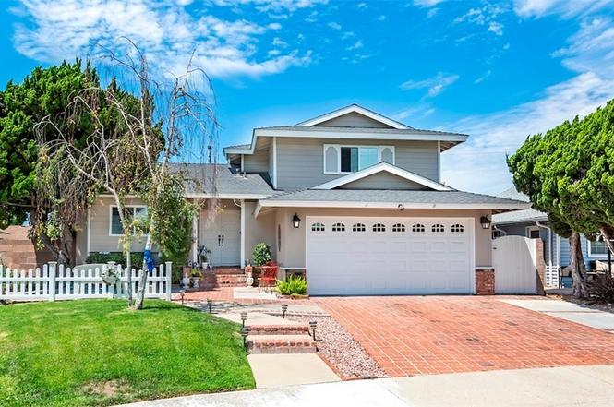
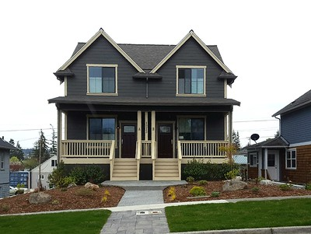
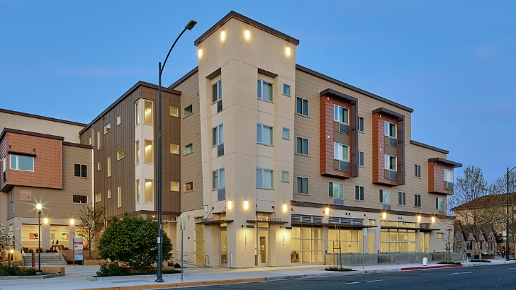
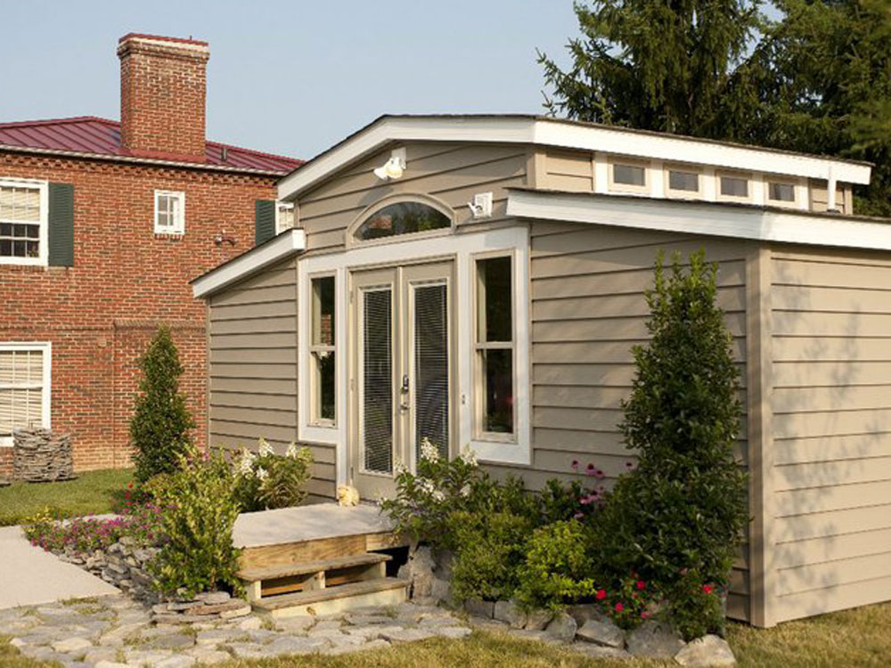
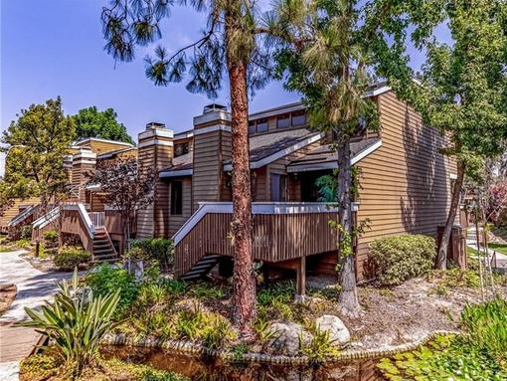
Housing Element Sites Assumption
Density = Affordability
Above Moderate
Income
Moderate
Income
Lower
Income
Single-Family
Duplex
Multi-Family
Housing
Accessory
Dwelling
Townhome
Notes:
Slide 20:
The allowed development density is important because it is linked to the analysis that shows how a jurisdiction can meet the lower income RHNA. The legislation assumes that there are economies of scale associated with higher density – and those economies of scale can help affordable housing be developed. So in the housing element, where higher density sites are identified, they are assumed to be able to meet the lower-income RHNA.

Slide 19
Environmental Justice
element
Notes:
Slide 19:
The City is also including an environmental justice component into the General Plan. The existing Health and Sustainability Element looks at many of these factors, however a new state law has additional requirements.

Slide 20
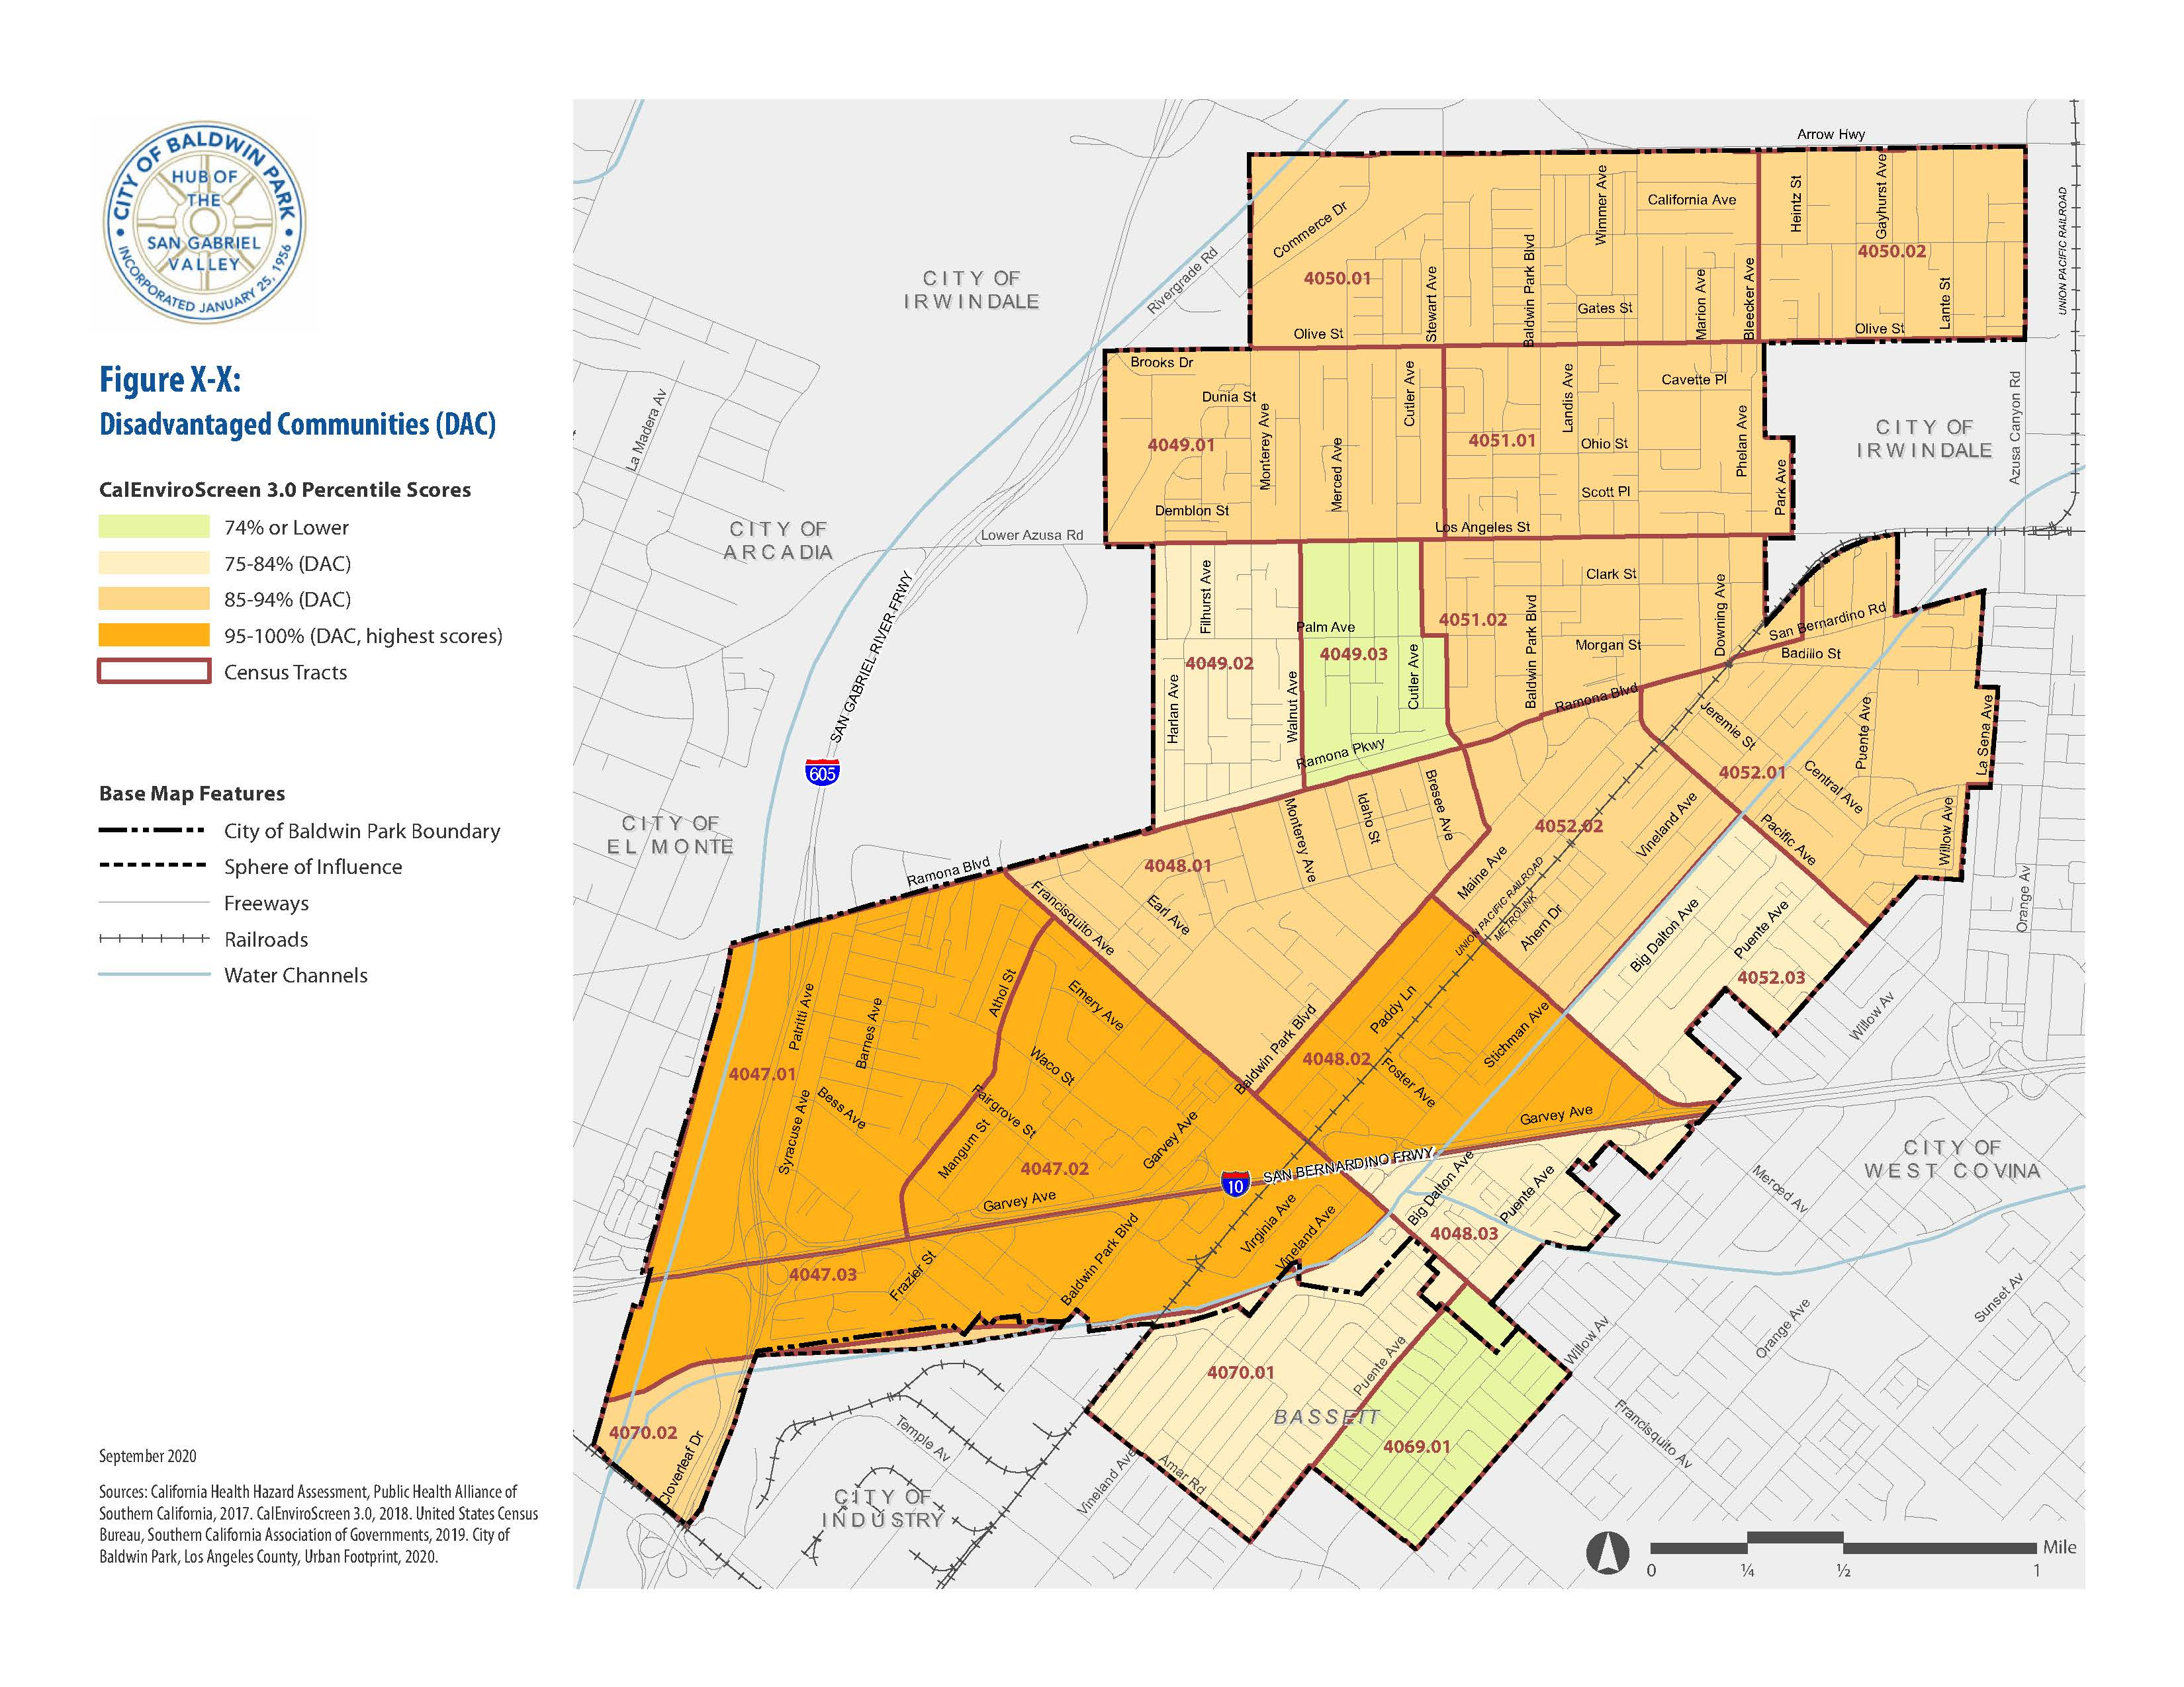
Notes:
Slide 20
Some communities bear a disproportionate burden of pollution and health risks. Environmental justice seeks to correct this inequality. Census tracts with a CalEnviroScreen percentile of 75% or more are considered “Disadvantaged Communities” with high risk of exposure to pollution in the air, water, or soil. These areas are often located near freeways, major roads, and/or industrial uses and have a high lower-income population.
The Environmental Justice Element will look at the areas indicated in orange and identify opportunities to improve quality of life and health outcomes in these areas, through access to community resources, healthy foods, parks, and community engagement.

Slide 21
Public engagement process
Notes:
Slide 21.

Slide 22



Process Overview and Public Engagement
Public Input
Public Input
Project Kickoff
Community Engagement
ADMIN/ PUBLIC REVIEW DRAFTS
Housing Element
ADMIN/ PUBLIC REVIEW DRAFTS
EJ and Safety Elements
Environmental Review and Adoption
October 2020 –
May 2021
March – June
2021
June –
October 2020
August 2020
April – June 2021
Housing Element Workshop
Environmental Justice Workshop
Community Surveys
Joint Study Sessions
Public Hearings
Analysis and Evaluation
Needs Assessment
Resources and Opportunities
Constraints
Goals, Policies, and Objectives
Analysis and Evaluation
Environmental Analysis
Final Documents
Notes:
Slide 22.
The Public Engagement process for this project will span from this fall through to next fall, with opportunities for further participation.
In addition to the workshop today, an online survey is currently open…

Slide 23
Online Community Survey
To be updated with survey graphics and bitly link on 10/27
English
Spanish
Notes:
Slide 23.
And looks to receive additional input on local housing needs and solutions. Please participate in this survey and share it widely among your networks. The survey will close on November 30, 2020.

Slide 24
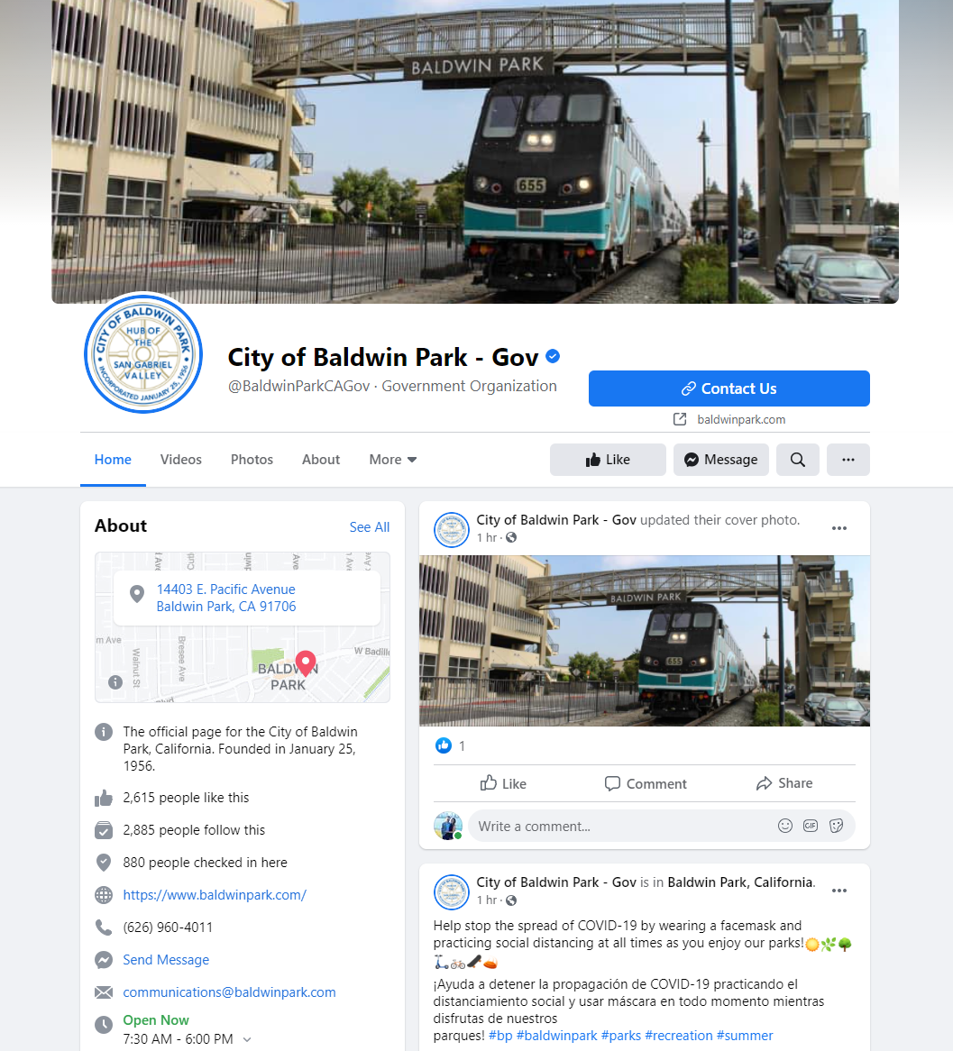
City Website and Facebook
Notes:
Slide 24
The City will continue to post additional information on the City’s website and the City’s facebook page.

Slide 25
Process Overview and Public Engagement
Public Input
Public Input
Project Kickoff
Community Engagement
ADMIN/ PUBLIC REVIEW DRAFTS
Housing Element
ADMIN/ PUBLIC REVIEW DRAFTS
EJ and Safety Elements
Environmental Review and Adoption
October 2020 –
May 2021
March – June
2021
June –
October 2020
August 2020
April – June 2021
Housing Element Workshop
Environmental Justice Workshop
Community Surveys
Joint Study Sessions
Public Hearings
Analysis and Evaluation
Needs Assessment
Resources and Opportunities
Constraints
Goals, Policies, and Objectives
Analysis and Evaluation
Environmental Analysis
Final Documents
Notes:
Slide 25.
In January there will be another community workshop focused on environmental justice and an accompanying survey. Joint study sessions with commission and hearings are also planned. Draft documents will be available for public review in late spring/early summer, and environmental review/adoption hearings will occur next fall.

Slide 26
Your Ideas
What are the major housing issues in Baldwin Park?
What are the challenges to overcome?
Where can new housing be accommodated?
What are creative solutions to address constraints?
Notes:
Slide 26
We’d like to hear from you:
What are the major housing issues in Baldwin Park?
What are the challenges to overcome?
Where can new housing be accommodated?
What are creative solutions to address constraints?

Slide 27
Community Workshop October 28, 2020
Housing Element

